Slide 1

3rd YEAR PROJECT PRESENTATION
On
ARTEMIS - Autonomous Reinforcement Trading with Episode-Mapped Intelligent Self-improvement
Submitted by
Surya Pratap Singh (2400971540133)
Tanishq Gupta (2400971540136)
Tauheed Ahmed (2400971540137)
Utkarsh Das (2400971540140)
Under the Supervision
of
Mr. Arvinda Kushwaha
Department of Data Science
Galgotias College of Engineering & Technology
Greater Noida, Uttar Pradesh

Slide 2
Outline
Introduction
Alignment with UN Sustainable Development Goals (SDGs 8 and 9)
Problem Statement
Literature Survey
Research Gap
Research Methodology
System Architecture
Implementation Progress
Result Analysis
Conclusion
References

Slide 3
Introduction
Reinforcement learning (RL) agents can be trained to trade stocks automatically - but they fail silently and cannot explain why they lost money.
Every existing RL trading system requires a human engineer to manually analyze failures, adjust the reward function, and retrain from scratch when performance degrades.
This bottleneck makes RL trading systems unscalable, slow to adapt, and dependent on domain expertise at every failure.
ARTEMIS introduces a closed-loop framework where the AI diagnoses its own trading failures using an attention-augmented LSTM and automatically adjusts its reward function using a SAC meta-policy - without any human intervention after initial setup.
The system trades NIFTY 50 (India) using real historical data from 2020 to 2024 across bull, bear, and sideways market regimes.

Slide 4
Alignment with UN Sustainable Development Goals (SDGs)
Alignment of Project with SDG 8 & SDG 9
SDG 8 – Decent Work & Economic Growth
Goal: Promote sustained, inclusive, and sustainable economic growth, full and productive employment, and decent work for all.
How ARTEMIS Aligns with SDG 8:
ARTEMIS democratizes access to AI-driven financial decision-making - technology previously available only to large institutions becomes accessible to small investors and researchers.
By automating reward engineering, ARTEMIS reduces the skilled-labor bottleneck in deploying RL trading systems, enabling broader economic participation in algorithmic finance.
More efficient and self-correcting trading agents contribute to healthier, more liquid capital markets - supporting sustainable economic growth.
ARTEMIS demonstrates that research-grade AI systems can be built on accessible CPU hardware - reducing the infrastructure cost barrier for economic innovation in developing markets.
The framework supports financial inclusion by making autonomous trading research possible without expensive cloud GPU infrastructure.

Slide 5
Alignment with UN Sustainable Development Goals (SDGs) Contd..
SDG 9 – Industry, Innovation & Infrastructure
Goal: Build resilient infrastructure, promote inclusive and sustainable industrialization, and foster innovation.
How ARTEMIS Aligns with SDG 9:
ARTEMIS introduces a primary research innovation: the first closed-loop meta-RL framework where reward engineering itself is treated as a reinforcement learning problem solved by a SAC meta-policy.
The attention-augmented LSTM that diagnoses structural trading failure modes from full episode trajectories is a novel AI architecture contribution applicable beyond finance.
The 14-module software infrastructure (data pipeline, trading environment, diagnostic model, meta-policy, ablation framework, and live dashboard) constitutes a reusable research platform for AI-in-finance applications.
ARTEMIS demonstrates that research-grade autonomous AI systems can be developed on standard CPU hardware - supporting innovation in regions with limited GPU infrastructure.
The open-source nature of the project builds shared digital research infrastructure for the academic community.

Slide 6
Alignment with UN Sustainable Development Goals (SDGs) Contd..
Summary
Focus Area | SDG Target Code | How ARTEMIS Addresses It
Financial Inclusion | SDG 8.3 | Democratizes access to AI trading — removes dependency on expensive institutional infrastructure
Economic Productivity | SDG 8.2 | Self-correcting reward engineering eliminates human bottleneck in RL trading deployment
Technology Innovation | SDG 9.5 | Novel meta-RL reward engineering framework — first of its kind in financial AI literature
Research Infrastructure | SDG 9.b | Open-source 14-module platform for AI-in-finance research, runs on standard CPU hardware
Digital Innovation | SDG 9.c | Accessible AI development demonstrated on Windows 11 CPU — no cloud or GPU dependency

Slide 7
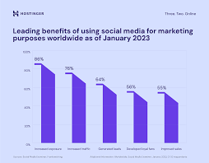
Problem Statement
RL trading agents require a reward function designed by a human expert before training begins — encoding intuitions about profit, risk, and trading behavior.
When the agent fails (panic selling, overtrading, holding losing positions), the engineer must: halt training, manually read episode logs, diagnose the failure, adjust reward weights, and restart - a process that can take days.
This bottleneck means RL trading systems cannot adapt to changing market conditions without constant human supervision.
No existing tool automatically diagnoses WHY an RL agent failed at the trajectory level AND learns a reward correction policy from that diagnosis.
The consequence: RL trading research is slower, more expensive, and more dependent on domain expertise than it needs to be.
ARTEMIS solves this by making the reward engineering loop fully autonomous - diagnosis → fix → retrain → evaluate - without human intervention.
The Reward Engineering Bottleneck in RL Trading

Slide 8
Literature Survey
Schulman, J., et al. (2017). Proximal Policy Optimization Algorithms. arXiv:1707.06347. PPO provides stable policy gradient updates for RL agents. Widely used in trading. Limitation: requires hand-crafted, static reward functions that don’t adapt when markets change.
Hochreiter, S., & Schmidhuber, J. (1997). Long Short-Term Memory. Neural Computation, 9(8), 1735–1780. LSTM captures long-range temporal dependencies - ideal for reading full 252-day trading episode trajectories to classify failure modes. ARTEMIS adds multi-head self-attention on top.
Ma, Y., et al. (2023). Eureka: Human-Level Reward Design via Coding Large Language Models. arXiv:2310.12931. Uses GPT-4 to write reward code from environment descriptions. Requires LLM API access at runtime and code generation ability. ARTEMIS instead learns adjustments from trajectory evidence - no LLM dependency after setup.

Slide 9
Literature Survey Contd…
Liu, X. Y., et al. (2022). FinRL: Deep Reinforcement Learning Framework to Automate Trading in Quantitative Finance. ACM ICAIF 2022. Open-source RL trading framework with multiple algorithms. Uses fixed hand-coded rewards — no self-correction capability. ARTEMIS adds a learned reward engineering layer on top of this class of frameworks.
Haarnoja, T., et al. (2018). Soft Actor-Critic: Off-Policy Maximum Entropy Deep Reinforcement Learning with a Stochastic Actor. ICML 2018. SAC is sample-efficient for continuous action spaces with entropy regularisation. ARTEMIS uses SAC for the meta-policy that outputs continuous delta adjustments to 6 reward weights — ideal because meta-episodes are short and SAC’s replay buffer maximizes data efficiency.

Slide 10
Literature Survey Contd…
Finn, C., Abbeel, P., & Levine, S. (2017). Model-Agnostic Meta-Learning for Fast Adaptation of Deep Networks. ICML 2017. MAML demonstrates that meta-learning over RL problems is achievable. ARTEMIS applies meta-RL specifically to reward engineering — the outer SAC agent learns reward parameters rather than policy parameters, a distinct and novel formulation.
Across all six papers, one gap stands out: no prior work closes the loop between diagnosing an RL trading failure and automatically learning a reward-correction policy. ARTEMIS combines the LSTM-based diagnosis of Hochreiter & Schmidhuber and the SAC meta-policy of Haarnoja to close that loop.

Slide 11
Literature Survey Contd…

Slide 12
Research Gap
Trajectory-Level Diagnosis Missing: Most RL diagnostics provide aggregate metrics (mean reward, episode length). No existing system reads the full sequence of trading decisions and classifies the structural failure pattern (panic sell, overtrade, missed rally, max drawdown).
Integration Challenge: Every existing approach addresses either failure diagnosis OR reward adjustment — never both in a closed loop without human intervention at each step.
Scalability Gap: Hand-coded reward fix rules (like “if PANIC_SELL then reduce drawdown penalty by 20%”) do not generalise across market regimes or asset classes. A rule that works for NIFTY 50 in a bull market may fail in a bear market or a sideways market.
Learning Gap: No existing system treats reward engineering itself as a reinforcement learning problem with a learnable policy. ARTEMIS formalises this as a meta-MDP and solves it with SAC — the core research contribution.

Slide 13
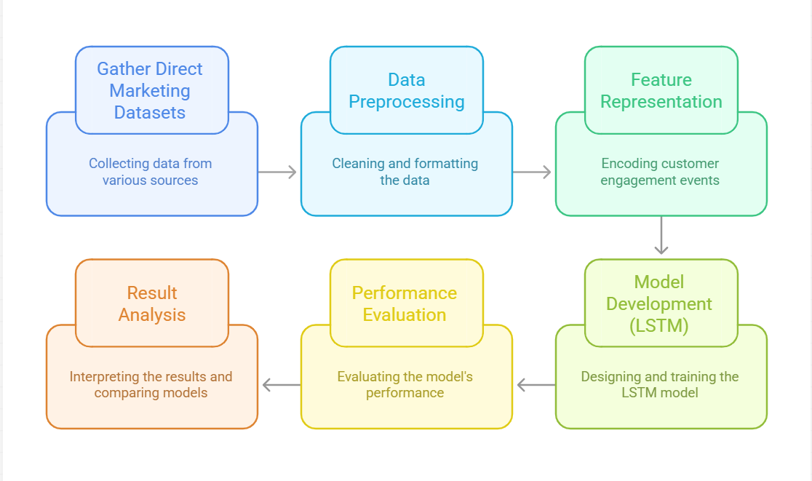
Research Methodology
Fig.1. Flowchart Depicting the ARTEMIS Closed-Loop Framework

Slide 14
Research Methodology Contd…
Data: yfinance API downloads NIFTY 50 (^NSEI) daily OHLCV data from 2020 to 2024 across bull, bear, and sideways regimes.
Trading environment: Custom Gymnasium env with 6 technical indicators, 10-dim observation space, 3 discrete actions (Buy/Hold/Sell), 252-day episodes, and a 6-parameter shaped reward.
Inner agent & LSTM training data: PPO trained via Stable-Baselines3, 500,000 steps per regime. 5 broken environment subclasses produce 300 labelled failure trajectories for supervised LSTM training.
Attention-augmented LSTM: 2-layer LSTM (hidden=64) + 4-head self-attention, reading full 252-day trajectories to jointly classify failure mode and fix type.
Meta-MDP & SAC meta-policy: 17-dim state (failure probs + reward weights + performance metrics), 6-dim continuous action bounded ±0.3. SAC trained for 2000 meta-steps to maximize Sharpe ratio improvement.
Accept/Reject gate: After each meta-step, PPO is finetuned for 20,000 steps; the new reward config is kept only if Sharpe ratio improves. Repeats for K=3 iterations.
Ablation study: 4 conditions — PPO only, hand-coded fixes, random fixes, ARTEMIS with SAC — each across 3 regimes × 5 seeds, tested with Wilcoxon signed-rank (α=0.05).

Slide 15
Result Analysis
Data pipeline: NIFTY 50 (465 bull rows, 215 bear rows, 313 sideways rows), BSE Sensex (1,056 rows), Gold futures (1,078 rows) — all downloaded and cached successfully.
Trading environment: obs shape (10,) confirmed. First step reward: −0.0025. Episode length: 252 steps. All 5 broken environments verified with distinct failure patterns.
LSTM architecture: Failure logits shape (2, 6) . Fix logits shape (2, 6) . Attention weights shape (2, 252, 252) . Gradient flow confirmed through all layers.
PPO smoke test: 500 steps trained in 9 seconds. Model saved. 2 evaluation episodes collected (252 steps each). evaluate() and benchmark_buy_and_hold() both return correct metrics.

Slide 16
Result Analysis Contd…
Implementation Verification Table:
Module | Status | Notes
Data Pipeline | Complete | Real NIFTY 50, Sensex, Gold data — verified
Trading Environment | Complete | 10-dim obs, shaped reward, 5 broken envs — all pass
PPO Agent | Partial (20%) | Smoke test passed. Full 500k-step training in progress.
LSTM Diagnostic | Code complete | Architecture verified. Training pending.
SAC Meta-Policy | Code complete | MetaEnv + SAC + inference — all import-verified.
Reward Fix Applicators | Complete | All 6 fixes correct, vector roundtrip verified.
Ablation Framework | Code complete | All 4 conditions importable and structurally verified.
Dashboard (7 tabs) | Code complete | Server starts clean. All 7 tabs render without errors.

Slide 17
Result Analysis Contd…
Bugs Found and Fixed: 5 real integration bugs were found and fixed during testing.
Bug 1: normalise() did not preserve raw Close price - TradingEnv traded on the min-max-scaled value. Fixed by carrying Close_raw alongside normalised features.
Bug 2: split_all() double-normalised bear/sideways data. Fixed by fitting on bull only and transforming bear/sideways.
Bug 3: get_trajectory() max-drawdown formula was wrong. Replaced with max() over per-step live drawdown values already computed.
Bug 4: Broken environment subclasses caused a KeyError from a missing reward config key. Fixed by merging with DEFAULT_REWARD_CONFIG before overriding.
Bug 5: run_meta_inference() caused a train/inference distribution mismatch. Fixed by reusing MetaEnv._build_obs() directly in inference.

Slide 18
Conclusion
ARTEMIS proposes the first closed-loop meta-RL framework that diagnoses RL trading failures at the trajectory level and automatically learns to adjust the reward function - solving the reward engineering bottleneck without any human intervention after initial setup.
All 18 modules are implemented and import-verified: data pipeline, trading environment, PPO agent, attention-augmented LSTM, SAC meta-policy, ablation framework, and 7-tab Streamlit live dashboard.
The system directly addresses SDG 8 (Decent Work and Economic Growth) by democratizing access to AI-driven financial tools, and SDG 9 (Industry, Innovation and Infrastructure) by introducing a novel meta-RL architecture that advances the state of the art in automated reward engineering.
Full training pipeline - PPO 500k steps, LSTM, SAC meta-policy, 4-condition ablation study - is the immediate next deliverable.
Target publication: ICAIF 2026 (ACM International Conference on AI in Finance) or NeurIPS Workshop on RL for Finance.

Slide 19
References
1. Schulman, J., et al. (2017). Proximal Policy Optimization Algorithms. arXiv:1707.06347.
2. Hochreiter, S., & Schmidhuber, J. (1997). Long Short-Term Memory. Neural Computation, 9(8), 1735–1780.
3. Haarnoja, T., et al. (2018). Soft Actor-Critic: Off-Policy Maximum Entropy Deep RL. ICML 2018.
4. Ma, Y., et al. (2023). Eureka: Human-Level Reward Design via Coding LLMs. arXiv:2310.12931.
5. Liu, X. Y., et al. (2022). FinRL: Deep RL Framework for Quantitative Finance. ACM ICAIF 2022.
6. Finn, C., Abbeel, P., & Levine, S. (2017). Model-Agnostic Meta-Learning. ICML 2017.
7. Towers, M., et al. (2023). Gymnasium: A Standard Interface for RL Environments. Farama Foundation.
8. Raffin, A., et al. (2021). Stable-Baselines3: Reliable RL Implementations. JMLR, 22(268), 1–8.
9. Paszke, A., et al. (2019). PyTorch: An Imperative Style Deep Learning Library. NeurIPS 32.

Slide 20
Thank You

